Slide 1


visuSolution GmbH
Realizing ideas
for a better vision
1/15

Slide 2




AGENDA
ABOUT US
Founders
Company overview
VISION &
MISSION
Goals & Objectives
Core values
OUR SOLUTIONS
Video centration
Future projects
Partnerships
2/15

Slide 3


ABOUT
US
The company visuSolution GmbH started on July 1st, 2016 as a strong partner for ophthalmic measurement instruments and electronic reading aids in Germany.
Our products concentrate on two main subjects:
➲ Digital Video Centration
Users are ophthalmic opticians that want to provide their customers best vision within a short time.
➲ Low Vision
Users are visually impaired people from 6 years old, placing great value in smart solutions for school, office or daily life, no matter if being on the road or at home.
3/15

Slide 4
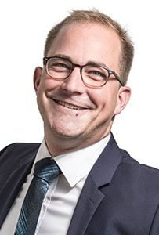
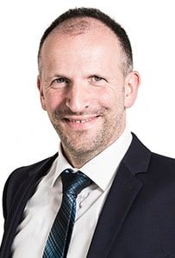

As one of our two managing directors, Arne Fischer ensures process adjustment and coherence in manufacturing and distribution. He lays great value in high-quality production that shines with efficiency.
OUR
FOUNDERS
Our other managing director, Maik Zwick, gives advice to our customers at all times. He develops purposeful concepts for the company expansion and represents us at fairs. With high-quality requirements he keeps the overview for customer advisory, communication in the company and PR.
4/15

Slide 5





COMPANY
OVERVIEW
Europe
Germany
Saxony-Anhalt
Altmark
Tangerhütte
Brunkau district
Customers worldwide
4,500 <
Partners worldwide
60 <
Video Centration
Systems sold 10,000 <
Low Vision
Devices sold 800 <
From 06.2018 data
5/15

Slide 6
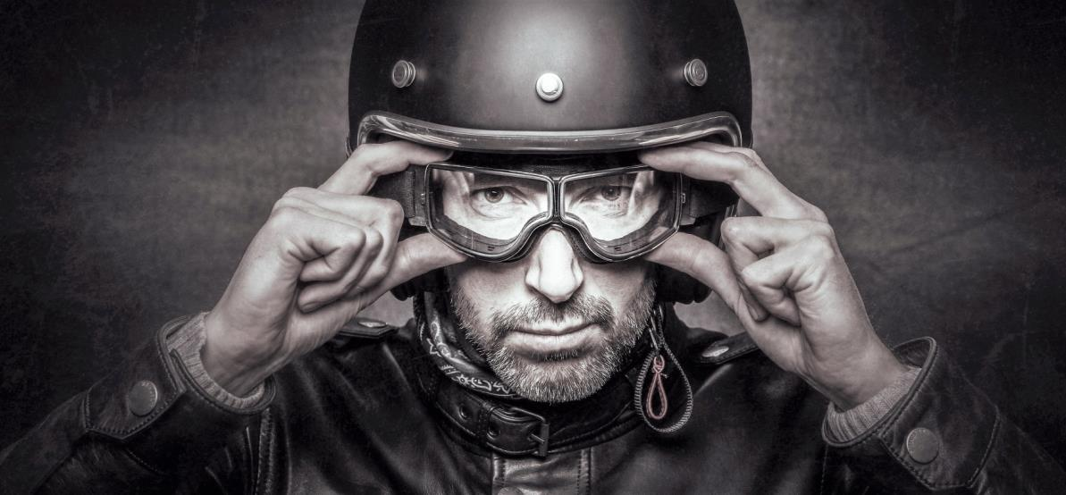
VISION
& MISSION
We realize ideas for better vision.
Worldwide specialists for digital centration and low vision
Passionate and dynamic predictors
Caring for high-grade, reliable products, fair price/performance ratio, accurate solutions and cooperative partnership.
6/15

Slide 7

OUR
GOALS &
OBJECTIVES
As worldwide specialist for digital centration and low vision and passionate predictors, we want to reach that our
customers are satisfied and feel understood and find themselves in good hands
suppliers and service partners place value on working with us as we are reliable, fair and work to very high quality standards
employees are engaged and proud of working with visuSolution, because they feel valued and challenged
7/15

Slide 8

OUR
CORE VALUES
In our daily business we put emphasis on special core values between each other as well as towards our customers, suppliers and third parties.
These core values are
Respect
Integrity
Responsibility
Cooperation
Professionalism
Engagement
8/15

Slide 9
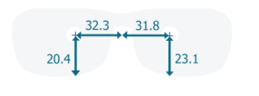
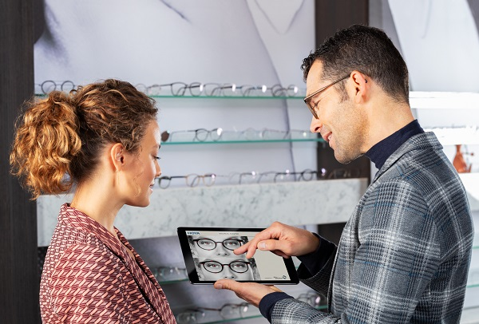
OUR
SOLUTIONS
Video Centration
precise measurement results for premium individual progressive lenses
Users are ophthalmic opticians that want to provide their customers best vision within a short time
9/15

Slide 10
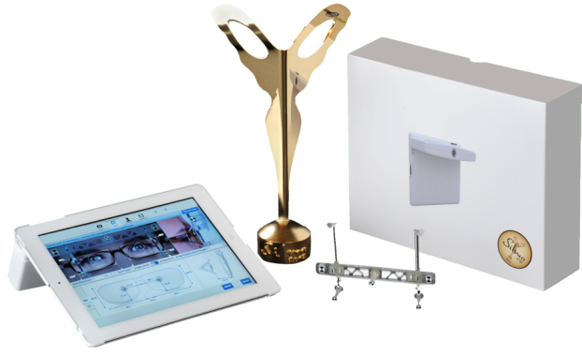
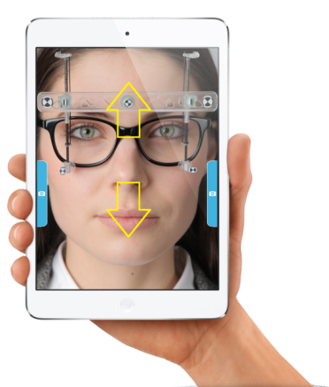
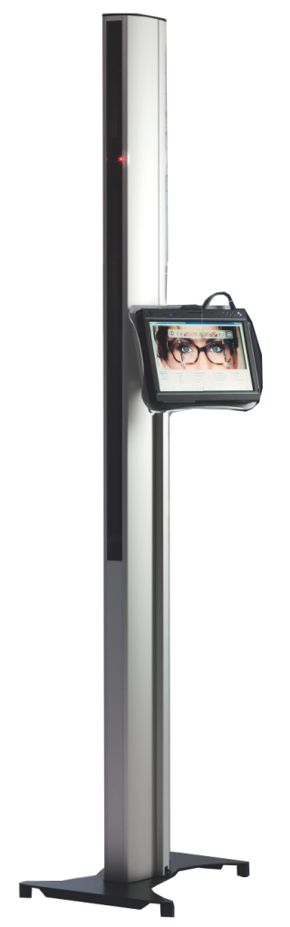
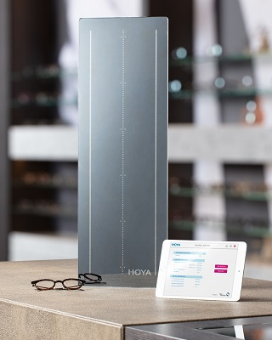
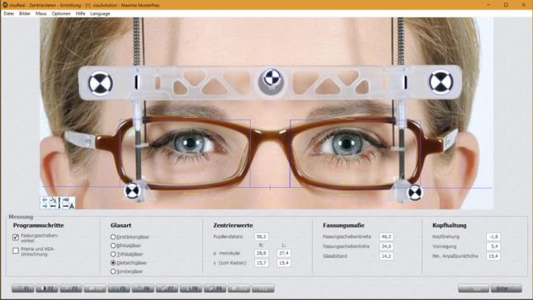
Mobile Systems
OUR SOLUTIONS
VIDEO CENTRATION
visuReal® PRO
visuReal® portable
Tower Systems
New generation
visuReal® MASTER
visuReal® Premium
Customized tower with HD cameras & laptop stand
10/15

Slide 11

OUR
FUTURE
PROJECTS
Our expertise and continuous efforts lead to new and innovative technologies with one goal in mind:
Sharing the gift of good vision.
Designed by our experts, our devices are developed to meet real-life demands. They feature top quality workmanship and represent top-class, high quality technology.
In a nutshell,
our products are optical innovations!
11/15

Slide 12






Some of
OUR
PARTNERSHIPS
12/15

Slide 13

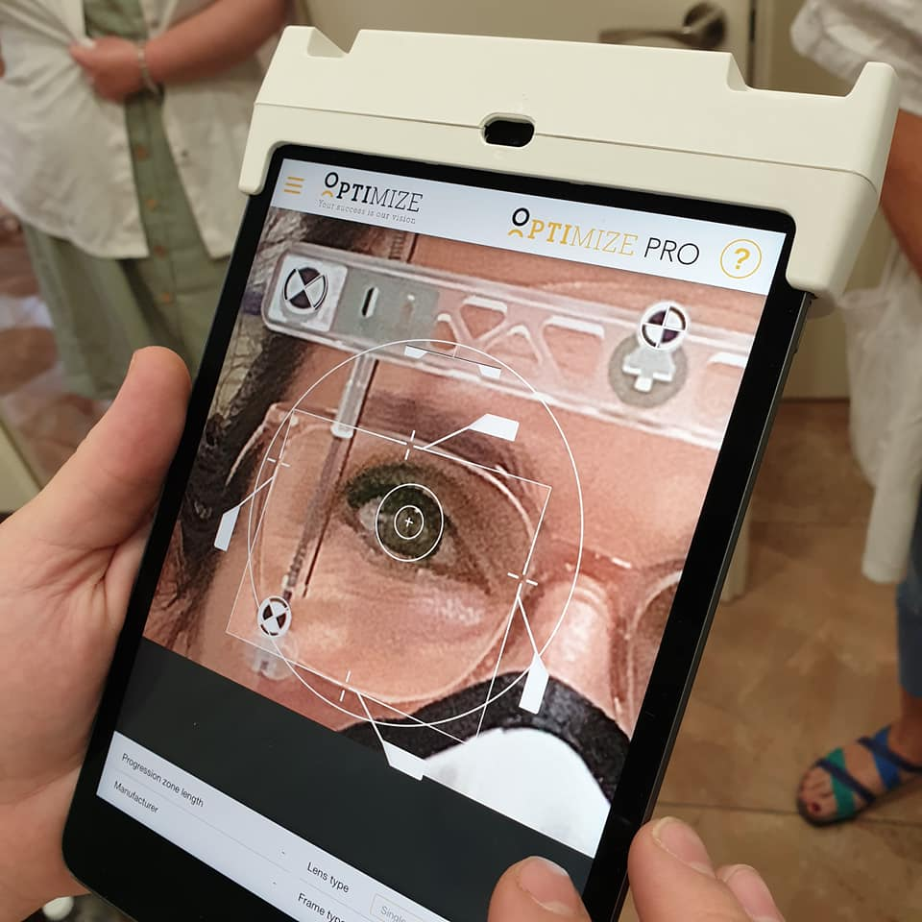
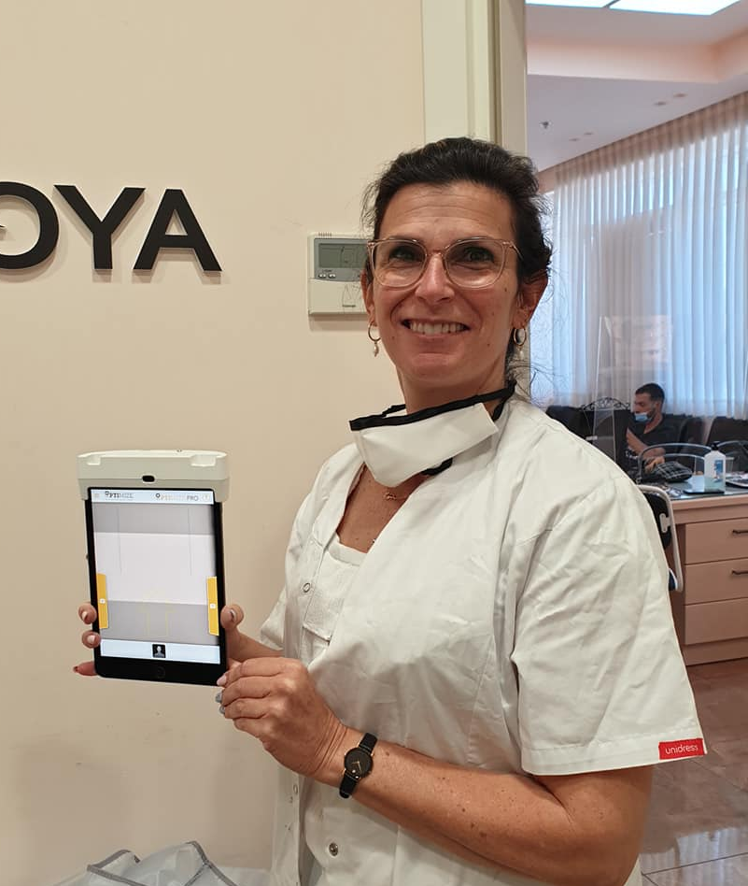
TESTIMONIALS
Our partner, Optimize PRO, have recently renewed their service contract with Eye World, one of the biggest sunglasses and eyewear shops in Jerusalem.
"The Optimize PRO offers a multifocal matching without compromise, besides a fast and easy adjustment" - Dr. Ari Titelbaum
The Optimize PRO is a
customized version of
the visuReal PRO device.
13/15

Slide 14



HOW TO
CONTACT US
Direct Contact
For international Sales and Marketing
Official Contact
Main Office
Maik Zwick
CEO visuSolution GmbH
m.zwick@visusolution.com
P. +49 (0) 1723171971
Carlos Romero
Int'l Sales Consultant at visuSolution GmbH
c.romero@visusolution.com
P. +81 (0) 50 7118 2063
visuSolution GmbH
Lüderitzer Weg 6
39517 Tangerhütte – Germany
Ortsteil Brunkau
Monday to Friday: 8 am – 5 pm
P. +49 (0) 39361-967-17
T. +49 (0) 39361-969-475
hotline@visusolution.com
On the web https://www.visusolution.com/
Follow Us on
14/15

Slide 15
THANK YOU!
15/15

